Slide 1
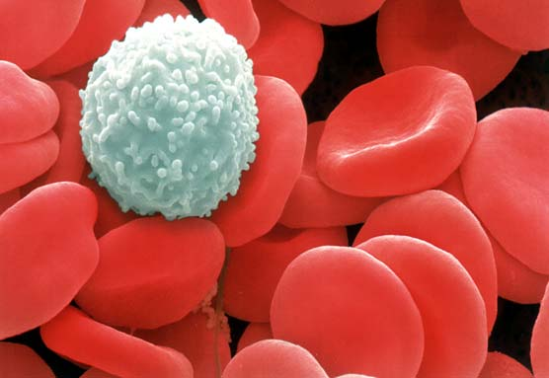
The Human Immune System
Video

Slide 2
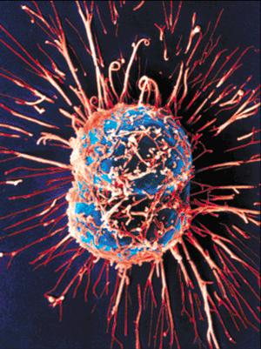
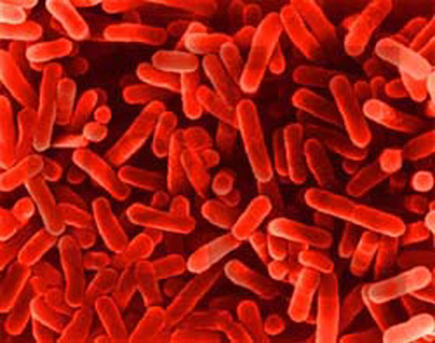
What is the immune system?
The body’s defense against disease causing organisms, malfunctioning cells, and foreign particles

Slide 3
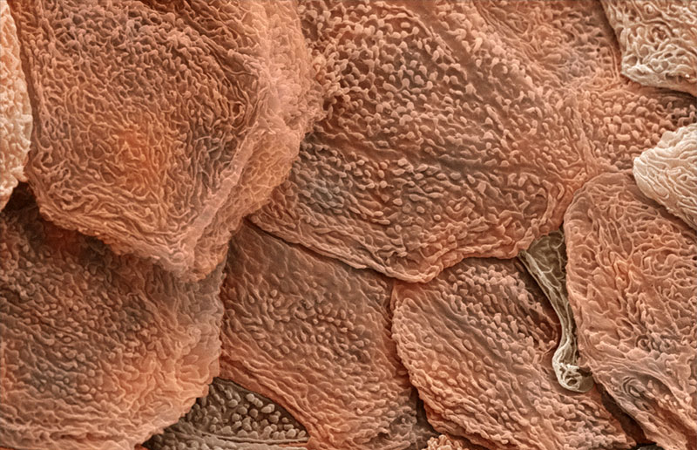
The First Line of Defense ~Skin~
The dead, outer layer of skin, known as the epidermis, forms a shield against invaders and secretes chemicals that kill potential invaders
You shed between 40 – 50 thousand skin cells every day!

Slide 4
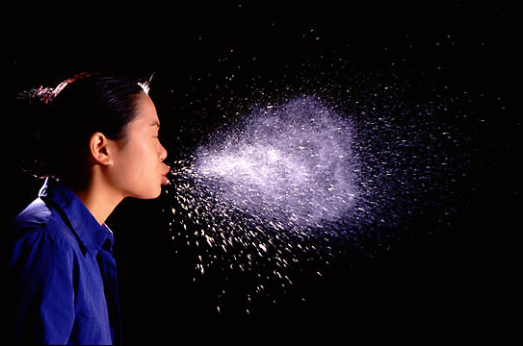
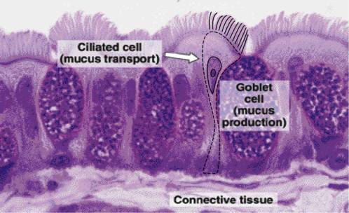
The First Line of Defense ~Mucus and Cilia~
As you breathe in, foreign particles and bacteria bump into mucus throughout your respiratory system and become stuck
Hair-like structures called cilia sweep this mucus into the throat for coughing or swallowing
Don’t swallowed bacteria have a good chance of infecting you?

Slide 5
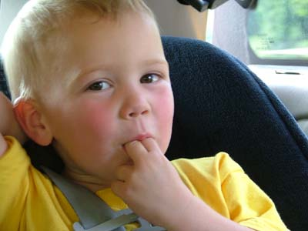
The First Line of Defense ~Saliva~
What’s the first thing you do when you cut your finger?
Saliva contains many chemicals that break down bacteria
Thousands of different types of bacteria can survive these chemicals, however

Slide 6
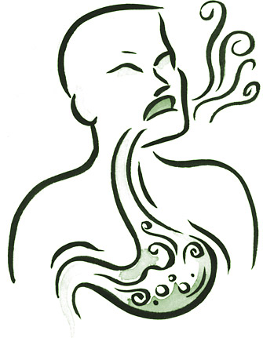
The First Line of Defense ~Stomach Acid~
Swallowed bacteria are broken down by incredibly strong acids in the stomach that break down your food
The stomach must produce a coating of special mucus or this acid would eat through the stomach!

Slide 7
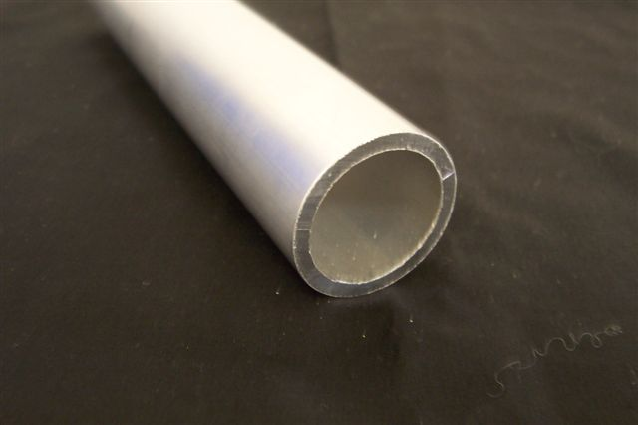
Think of the human body as a hollow plastic tube…
The food is digested within the hole in the tube, but it never actually enters into the solid plastic material.
Tube inner surface ~Digestive System~
Tube outer surface ~Skin~
Plastic interior ~Body~

Slide 8
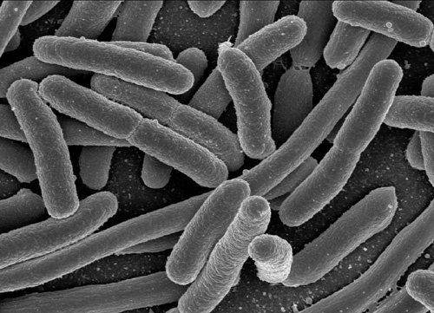
Escherichia coli is common and plentiful in all of our digestive tracts. Why are we all not sick?
These bacteria are technically outside the body and aid in digesting material we cannot
Only if E.Coli are introduced in an unnatural manner can they break through the first line of defense and harm us

Slide 9
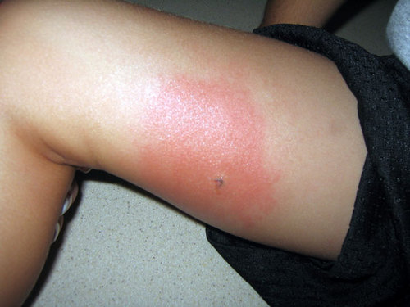
The Second Line of Defense ~The Inflammatory Response~
Injured body cells release chemicals called histamines, which begin inflammatory response
Capillaries dilate
Pyrogens released, reach hypothalamus, and temperature rises
Pain receptors activate
WBCs flock to infected area like sharks to blood

Slide 10
The Third Line of Defense ~The Immune Response~
The cells of the immune system can distinguish between different kinds of pathogens. The cells react to each kind of pathogen with a defense targeted specifically at that pathogen.
A pathogen is an organism that causes a disease.
White blood cells that can distinguish between different pathogens are called lymphocytes.

Slide 11
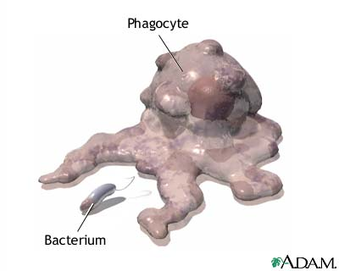
White Blood Cells
~Phagocytes~
These white blood cells are responsible for eating foreign particles by engulfing them
Once engulfed, the phagocyte breaks the foreign particles apart in organelles called ________
Lysosomes
Where could invaders hide from phagocytes?

Slide 12
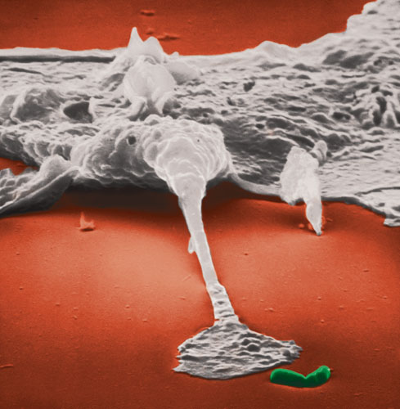
~White Blood Cells~
If invaders actually get within the body, then your white blood cells (WBCs) begin their attack
WBCs normally circulate throughout the blood, but will enter the body’s tissues if invaders are detected
Video

Slide 13
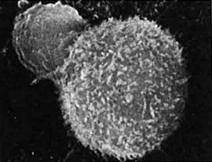
White Blood Cells ~T-Cells~
T-Cells, a type of lymphocyte, can identify pathogens and distinguish one kind from another.
T-cells will attack these infected cells, quickly kill them, and then continue to search for more cells to kill
T-cells look for antigens, which are markers on the cells so that the T cell can recognize that cell as being a pathogen or part of your body

Slide 15
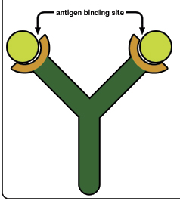
~Antibodies~
Lymphocytes called B cells produce proteins that help destroy pathogens. These proteins are called antibodies.
Proteins that latch onto, damage, clump, and slow foreign particles
Each antibody binds only to one specific binding site, known as an antigen
When antibodies bind to the antigen of a pathogen, they mark that pathogen for destruction.

Slide 16
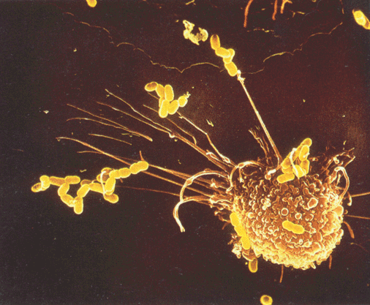
Antibody Production
WBCs gobble up invading particles and break them up
They show the particle pieces to T-cells, who identify the pieces and find specific B-cells to help
B-cells produce antibodies that are equipped to find that specific piece on a new particle and attach
Video - 1:58

Slide 17
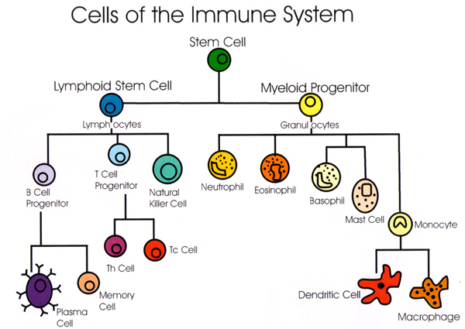
Immunity
New particles take longer to identify, and a person remains ill until a new antibody can be crafted
Old particles are quickly recognized, and a person may never become ill from that invader again. This person is now immune.

Slide 18
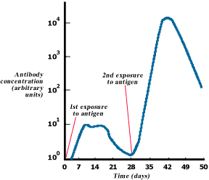

Slide 19
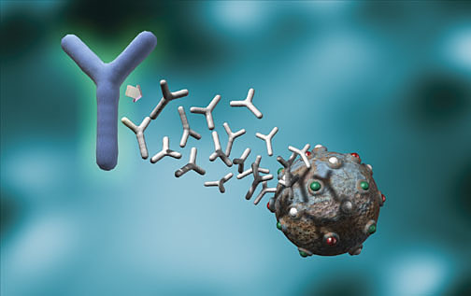
What is immunity?
Resistance to a disease causing organism or harmful substance
Two types
Active Immunity
Passive Immunity

Slide 20
Active Immunity
You produce the antibodies
Your body has been exposed to the antigen in the past either through:
Exposure to the actual disease causing antigen – You fought it, you won, you remember it
Planned exposure to a form of the antigen that has been killed or weakened – You detected it, eliminated it, and remember it
What is this second type of exposure called?

Slide 21
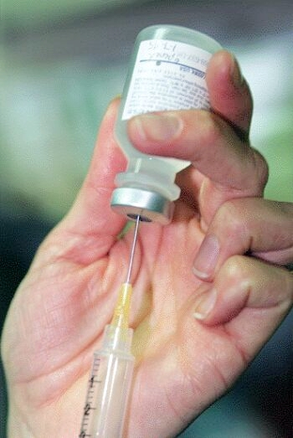
How long does active immunity last?
It depends on the antigen
Some disease-causing bacteria multiply into new forms that our body doesn’t recognize, requiring annual vaccinations, like the flu shot
Booster shot - reminds the immune system of the antigen
Others last for a lifetime, such as chicken pox

Slide 22
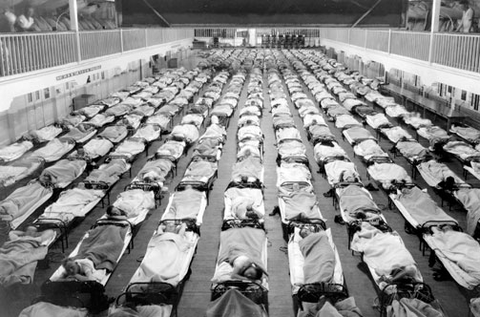
Think the flu is no big deal?
Think again…
In 1918, a particularly deadly strain of flu, called the Spanish Influenza, spread across the globe
It infected 20% of the human population and killed 5%, which came out to be about 100 million people

Slide 23
Passive Immunity
You don’t produce the antibodies
A mother will pass immunities on to her baby during pregnancy - through what organ?
These antibodies will protect the baby for a short period of time following birth while its immune system develops. What endocrine gland is responsible for this?
Lasts until antibodies die
Placenta
Why doesn’t the mother just pass on the WBCs that “remember” the antigens?
Thymus

Slide 24
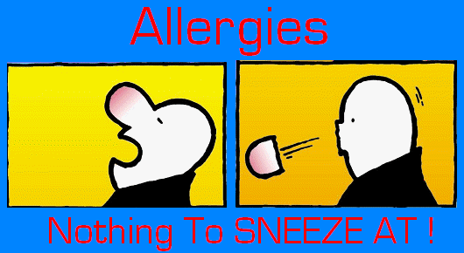
Immune Disorders ~Allergies~
Immune system mistakenly recognizes harmless foreign particles as serious threats
Launches immune response, which causes sneezing, runny nose, and watery eyes
Anti-histamines block effect of histamines and bring relief to allergy sufferers

Slide 25
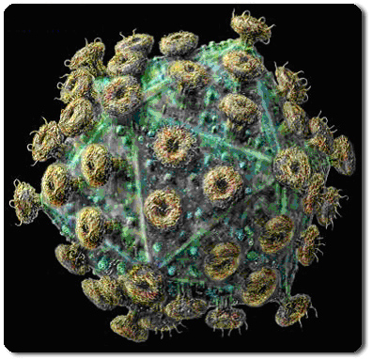
Aquired Immune Deficiency Syndrome
Caused by the Human Immunodeficiency Virus
Discovered in 1983
Specifically targets and kills T-cells
Because normal body cells are unaffected, immune response is not launched

Slide 26
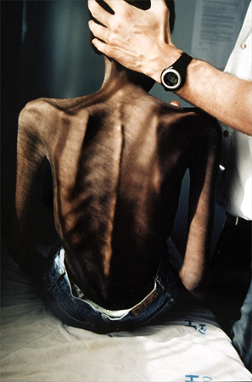
AIDS ~The Modern Plague~
The HIV virus doesn’t kill you – it cripples your immune system
With your immune system shut down, common diseases that your immune system normally could defeat become life-threatening
Can show no effects for several months all the way up to 10 years

Slide 27
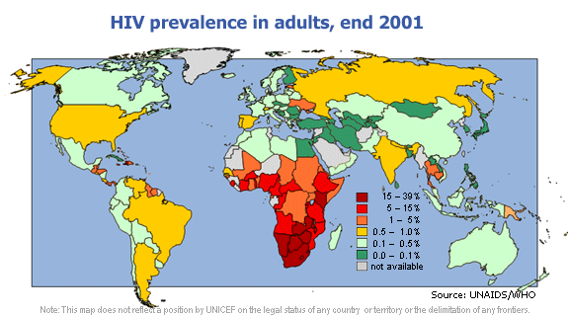
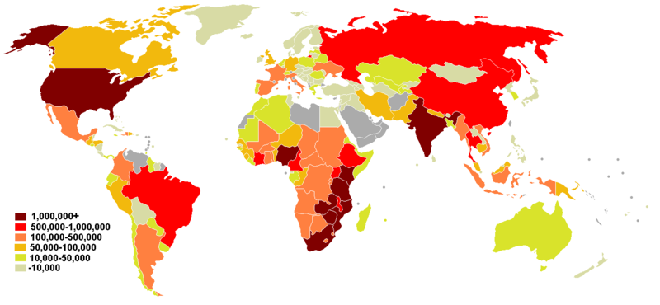
AIDS ~The Silent Spread~
Transmitted by sexual contact, blood transfusions, contaminated needles
As of 2007, it affects an estimated 33.2 million people

